Slide 1


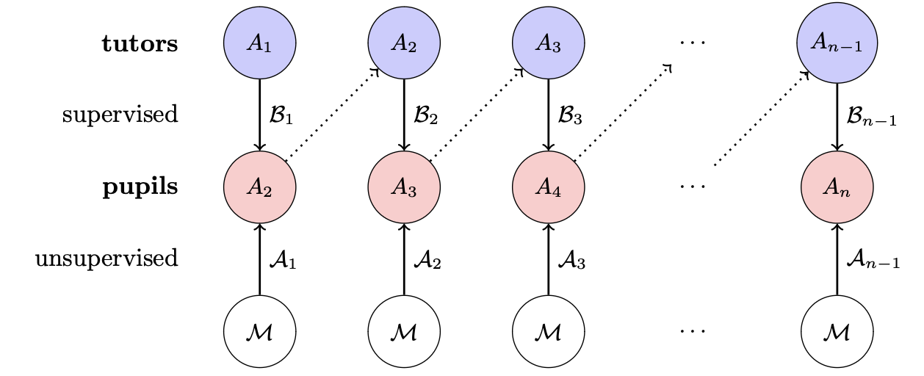
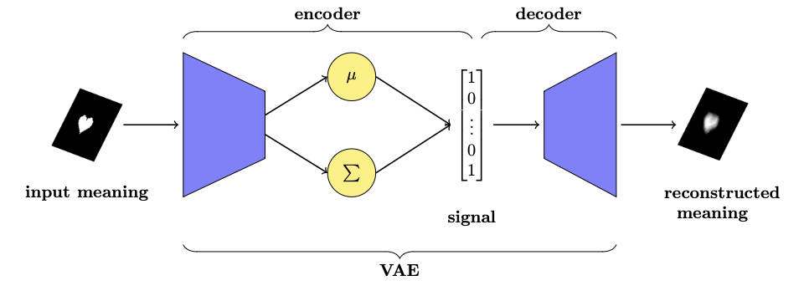
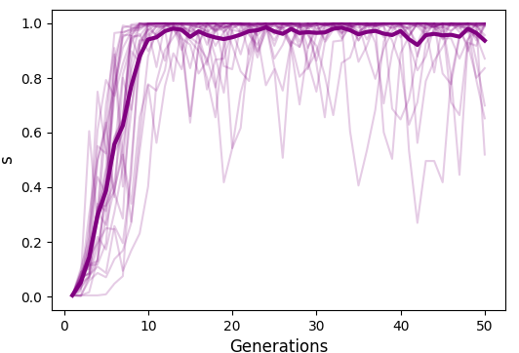
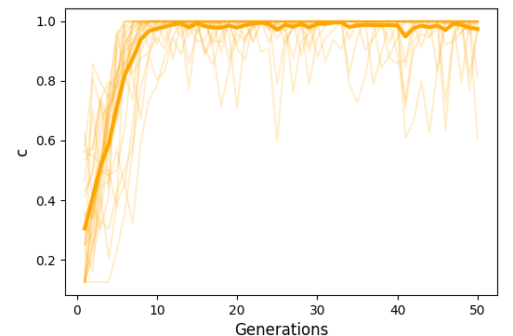
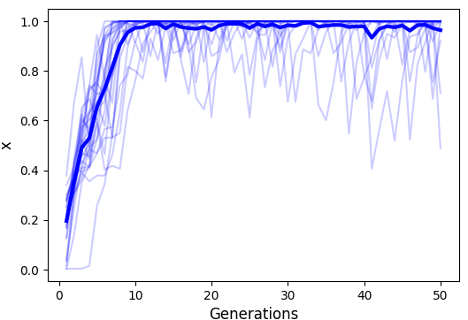
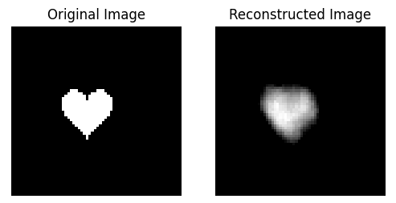
How We Learned A Language Before Duolingo
Hyoyeon Lee¹, supervised by Dr Seth Bullock¹ and Dr Conor Houghton²
1 School of Computer Science, University of Bristol
2 School of Engineering Mathematics and Technology, University of Bristol
Introduction & Objectives
Linguistics is the scientific study of language, focusing on structure, grammar, meaning, and evolution.
Computational modelling help explore key questions:
1. What properties make human languages learnable and interpretable for communication?
2. How do languages obtain these properties?
I built an ILM using a Variational Autoencoder and explore whether image-based meaning space exhibits similar properties.
SSILM Training Process (Replication)^{[1]}
Image-based SSILM with VAE
Supervised: child-directed language learning
Unsupervised: child hearing utterances related to some
situations they are engaged in
Limitations of SSILM:
Replicated SSILM Evaluation (Metrics)
n-bit binary vectors are too simplistic to capture the
richness of human language
Enforce a 1-to-1 mapping between meaning-signals
Implementation of SSILM with VAE:
Samples a probabilistic distribution and a latent
representation via reparameterisation trick
Stability
Expressivity
Compositionality
Enables larger meaning space with visual meanings
Better reflects human uncertainty and variability by
matching a distribution with single meaning
Results
Current Process & Goals:
Analyse if the new model follows the same trends in stability, expressivity, and compositionality as prior models.
Develop a new calculation method for compositionality.
Reference
[1] Jack Bunyan, Seth Bullock, and Conor Houghton. An iterated learning model of language change that mixes supervised and unsupervised learning. 2024. arXiv:2405.20818.

